Slide 1
Database Systems

Slide 2
Introduction
Databases are at the Centre of most information systems in everyday use
It is important that they are designed and built using appropriate methods
This will ensure that they meet users’ requirements
A database system is usually regarded as the database
It contains related tables of data maintained by a database management system (DBMS)
GIT 1201

Slide 3
Introduction…
Applications that provide controlled access to the database are part of a database system.
Databases are the foundations of most system in the modern world.
Databases are Backend work process
The Frontend (Applications) direct the databases.
GIT 1201

Slide 4
Introduction
Database: A shared collection of logically related data (and a description of this data), designed to meet the information needs of an organization.
An organized collection of information, or data, typically stored electronically in a computer system.
A database is usually controlled by a database management system (DBMS).
The data, the DBMS, and the applications that are associated with them, are referred to as a database system, often shortened to just database.
GIT 1201

Slide 5
Introduction…
A logically coherent collection of related data that
  (i) describes the entities and their inter-relationships, and
  (ii) is designed, built & populated for a specific reason
The database is a single, possibly large repository of data,
  can be used simultaneously by many departments and users.
GIT 1201

Slide 6
Introduction…
It is normally not owned by any one department or user but
It is a shared corporate resource.
As well as holding the organization’s operational data,
The database also holds a description of this data.
For this reason, a database is also defined as a self-describing collection of integrated records.
GIT 1201

Slide 7
Introduction…
The description of the data, that is the meta-data – the ‘data about data’ –
  is known as the system catalog or data dictionary.
It is the self-describing nature of a database that provides what’s known as data independence.
The primary goal of a DBMS is to provide a way to store and retrieve database information that is both;
  convenient and efficient.
GIT 1201

Slide 8
Introduction…
Database systems are designed to manage large bodies of information.
GIT 1201

Slide 9
Database System
A collection of application programs that interact with the database along with the DBMS and the database itself.
A database system consists of four components:
  users,
  the database application,
  the database management system (DBMS), and
  the database.
GIT 1201

Slide 10
Database System…
The database - a collection of related tables and other structures.
The database management system (DBMS): a program used to create, process, and administer the database.
  The DBMS receives requests encoded in SQL and translates the requests into actions on the database.
A database application: a set of one or more computer programs that serves as an intermediary between the user and the DBMS.
GIT 1201

Slide 11
Database System…
  Read or modify database data by sending SQL statements to the DBMS.
  Present data to users in the format of forms and reports
Users: People who interact with the database with the help of application interface
  Employ a database application to keep track of things.
  They use forms to read, enter, and query data, and
GIT 1201

Slide 12
Database System…
  They produce reports to convey information.
Database System = Database + Database Management System
GIT 1201

Slide 13
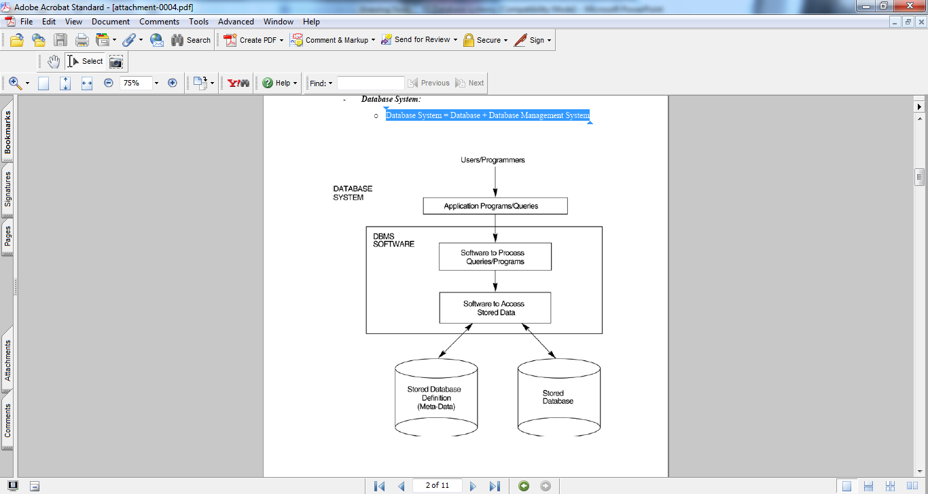
Database System…
GIT 1201

Slide 14
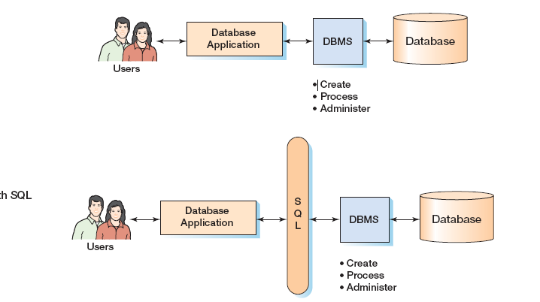
Database System…
GIT 1201

Slide 15
Uses/Application of Database Systems
Banking - all transactions
Airlines - reservations, schedules
Universities - registration, grades
Sales - customers, products, purchases
Manufacturing - production, inventory, orders, supply chain
Human resources - employee records, salaries, tax deductions
Internet purchasing systems
Media archives for radio/tv stations
GIT 1201

Slide 16
Uses of database systems…
Using the local library: Details of books in the library, readers and reservations
Renting a video: Video titles in stock, copies available for each title, whether it is available for rent or not etc
NB:
Databases touch all aspects of our lives
GIT 1201

Slide 17
File-based systems
Database applications were built on top of file systems
File-based systems - Collection of application programs that perform services for the end users (e.g. reports).
Data is stored in one or more separate computer files defined and managed by different application .
In file systems, each department has its own files, designed specifically for those applications.
Each program defines and manages its own data.
GIT 1201

Slide 18
File-based systems…
An early attempt to computerize the manual filing system.
Originated from manual file systems
The approach is largely obsolete, there are good reasons for studying it
The manual filing system works well for a small number of items.
It even works adequately for large numbers of items designed for storage and retrieval.
GIT 1201

Slide 19
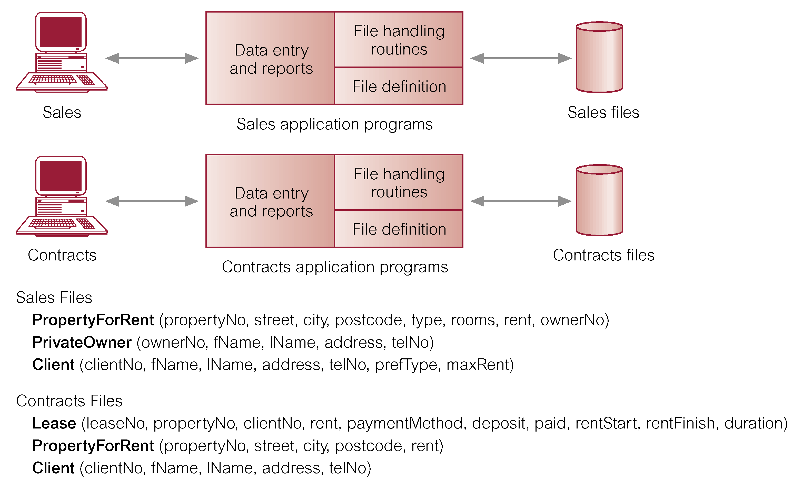
File-based processing
GIT 1201

Slide 20
File-based processing…
It can be seen quite clearly that there is a significant amount of duplication of data
This is generally true of file-based systems.
GIT 1201

Slide 21
Limitations of File-based Approach
Separation and isolation of data
  Data is stored in separate files, difficult to access
  Multiple files and formats
Duplication of data
  Duplication is wasteful. It costs time and money to enter the data more than once.
  duplication can lead to loss of data integrity; in other words, the data is no longer consistent.
Incompatible file formats
  Difficult to process jointly
GIT 1201

Slide 22
Limitations of File-based Approach...
Data dependence
  File structure is defined in the program code.
  Changes to an existing structure are difficult to make.
Data redundancy and inconsistency
  Multiple file formats, duplication of information in different files
Difficulty in accessing data
  Need to write a new program to carry out each new task
GIT 1201

Slide 23
Limitations of File-based Approach...
Integrity problems/Fixed Queries
  Dependent upon the application developer to write any queries or reports that are required
  The query or report that could be produced was fixed.
Security
  Security features such as locking out part of the files /safeguarding data confidentiality are difficult
GIT 1201

Slide 24
Limitations of File-based Approach...
Recovery, in the event of a hardware or software failure, was limited or nonexistent.
Restricted Access: Access to the files was restricted to one user at a time
  there was no provision for shared access by staff in the same department.
GIT 1201

Slide 25
Database Approach
Arose because:
  Definition of data was embedded in application programs, rather than being stored separately and independently.
  No control over access and manipulation of data beyond that imposed by application programs.
Result
  The Database and Database Management System (DBMS).
GIT 1201

Slide 26
The Database Management System (DBMS)
A software system that enables users to define, create, and maintain the database and
also provides controlled access to this database.
The DBMS is the software that interacts with the users, application programs, and the database.
The DBMS allows users to insert, update, delete, and retrieve data from the database.
GIT 1201

Slide 27
The Database Management System (DBMS)…
DBMS provides a general inquiry facility to this data, called a query language.
  Examples:
  Microsoft Access,
  Microsoft SQL Server and
  Oracle
GIT 1201

Slide 28
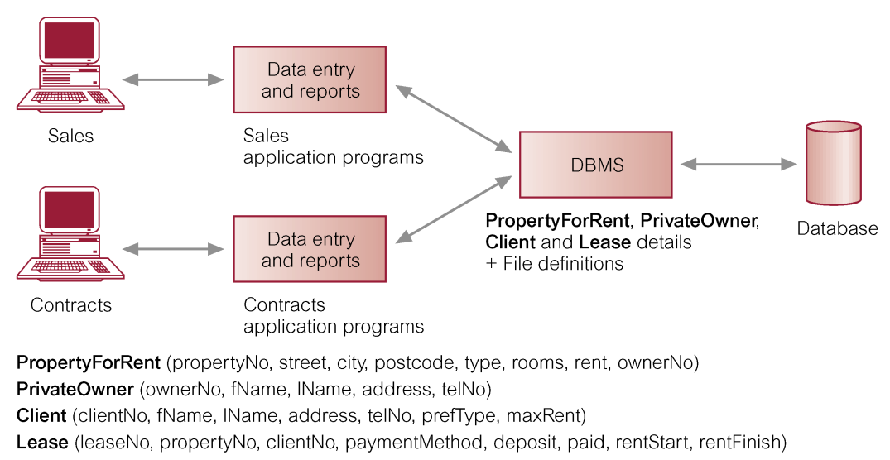
The Database Management System (DBMS)…
GIT 1201

Slide 29
Database Approach
Instead of disconnected files with redundant data,
All data items are integrated with a minimum amount of duplication.
The database is no longer owned by one department but is a shared corporate resource.
Typically, a DBMS provides the following facilities:
Data definition language (DDL).
  Permits specification of data types, structures and any data constraints.
  All specifications are stored in the database.
GIT 1201

Slide 30
Database Approach…
Data manipulation language (DML).
  General enquiry facility (query language) of the data.
GIT 1201

Slide 31
Database Application Programs
A computer program that interacts with the database by issuing an appropriate request (typically an SQL statement) to the DBMS.
Users interact with the database through a number of application programs
Used to create and maintain the database and to generate information.
Application programs may be written in some programming language
GIT 1201

Slide 32
Database Application Programs…
Each set of application programs handles data entry, maintenance, and the generation of reports.
The physical structure and storage of the data are managed by the DBMS.
GIT 1201

Slide 33
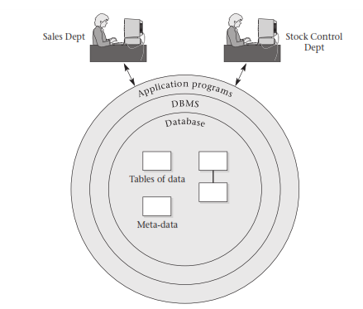
Database Application Programs
The database approach showing Sales and Stock Control Departments accessing the database through application programs and the DBMS.
GIT 1201

Slide 34
DBMS Architecture
Before the Web, generally a DBMS would be divided into two parts:
A client program that handles the main business and data processing logic and interfaces with the user;
A server program (sometimes called the DBMS engine) that manages and controls access to the database.
This is known as a (two-tier) client–server architecture.
GIT 1201

Slide 35
DBMS Architecture
This is called a client–server architecture:
  the backend is the server and
  The frontends are the clients.
GIT 1201

Slide 36
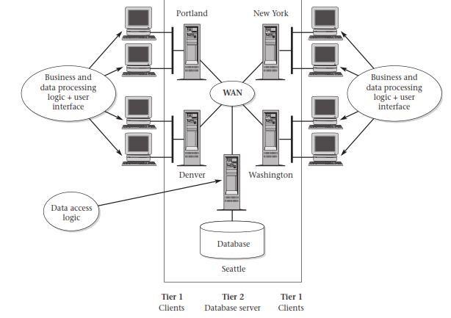
StayHome- Client Server Architecture
GIT 1201

Slide 37
3-tier architecture
This new architecture proposed three layers, each potentially running on a different platform:
Many Web applications use the three-tier architecture
This adds an intermediate layer between the client and the database server
The user interface layer, which runs on the end-user’s computer (the client).
the client end communicates with an application server
GIT 1201

Slide 38
3-tier architecture…
The business logic and data processing layer. says what actions to carry out under what conditions
Enables remote access
This middle tier runs on a server and is often called the application server.
  One application server is designed to serve multiple clients.
A DBMS, which stores the data required by the middle tier.
GIT 1201

Slide 39
3-tier architecture…
This tier may run on a separate server called the database server.
GIT 1201

Slide 40
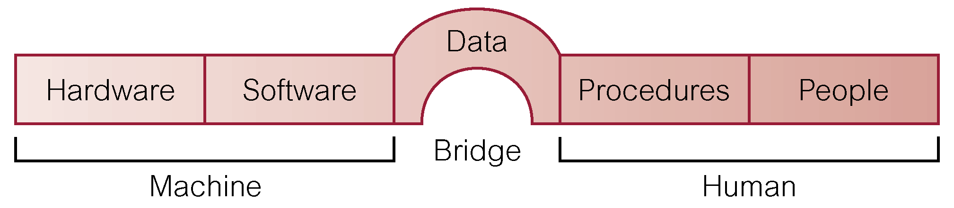
Components of the DBMS environment
GIT 1201

Slide 41
Components of the DBMS environment…
There are five major components in the DBMS environment:
Hardware, software, data, procedures, and people:
Hardware The computer system(s) that the DBMS and the application programs run on.
  This can range from a single PC, to a single mainframe, to a network of computers.
Software The DBMS software and the application programs, together with the operating system, including network software if over a network.
GIT 1201

Slide 42
Components of the DBMS environment…
Data: Information stored in the database
The data acts as a bridge between the hardware, software components and the human components.
  The database also contains both the operational data and the meta-data (the ‘data about data’).
Procedures The instructions and rules that govern the design and use of the database.
This may include instructions on;
  how to log on to the DBMS,
GIT 1201

Slide 43
Components of the DBMS environment…
  make backup copies of the database, and
  how to handle hardware or software failures.
  Use a particular DBMS facility or application program.
  Start and stop the DBMS.
People The people involved with the system.
This includes the:
  database designers, database administrators (DBAs), application programmers, and the end-users.
GIT 1201

Slide 44
Roles in the Database Environment
Data Administrator (DA)
Database Administrator (DBA)
Database Designers (Logical and Physical)
Application Programmers
End Users (naive and sophisticated)
GIT 1201

Slide 45
Functions of DBMS
Below are the functions and services of a full-scale DBMS to provide:
Data storage, retrieval, and update: In providing this functionality the DBMS should hide the internal physical implementation details from the user.
A user-accessible catalog: A DBMS provides an integrated system catalog that holds data about the structure of the database, users, applications, and so on.
  The catalog is accessible to users as well as to the DBMS.
GIT 1201

Slide 46
Functions of DBMS…
Concurrency control services: DBMS enables many users to access shared data concurrently;
  this is known as concurrency control
Recovery services: Returning the database to a consistent state after a transaction fails;
  this is known as recovery control.
  This may be the result of a system crash, media failure, a hardware or software error causing the DBMS to stop,
GIT 1201

Slide 47
Functions of DBMS….
Authorization services: Protect some of the data stored in the database from being seen by all users.
Support for data communication: Allow users to access the database from both the terminals and also remotely over a network.
    In either case, the DBMS must be capable of integrating with networking/communication software.
GIT 1201

Slide 48
Functions of DBMS…
Integrity services: Database integrity refers to the correctness and consistency of stored data.
  Can be considered as another type of database protection.
  While it’s related to security, it has wider implications; integrity is concerned with the quality of data itself
GIT 1201

Slide 49
Advantages of DBMS
Control of data redundancy: The database approach eliminates redundancy.
  It does not eliminate redundancy entirely,
  It controls the amount of redundancy inherent in the database.
Data consistency: By eliminating or controlling redundancy, we’re reducing the risk of inconsistencies occurring
Improved data integrity: Usually expressed in terms of constraints, which are consistency rules that the database is not permitted to violate.
GIT 1201

Slide 50
Advantages of DBMS…
Sharing of data: In a file-based approach (the predecessor to the DBMS approach), typically files are owned by the people or departments that use them.
  On the other hand, the database belongs to the entire organization and can be shared by all authorized users.
Improved maintenance through data independence: Since a DBMS separates the data descriptions from the applications, it helps make applications immune to changes in the data descriptions.
GIT 1201

Slide 51
Advantages of DBMS…
Improved security: protection of the database from unauthorized users
Enforcement of standards: integration allows the DBA to define and the DBMS to enforce the necessary standards.
Economy of scale: combining all the organization’s operational data into one database result in cost savings.
Balanced conflicting requirements: the DBA can make decisions about the design and operational use of the database that provide the best use of resources for the organization as a whole.
GIT 1201

Slide 52
Improved data accessibility and responsiveness: data that crosses departmental boundaries is directly accessible to the end users.
Increased concurrency: two or more users are allowed to access the same file simultaneously,
Improved backup and recovery services
GIT 1201

Slide 53
Disadvantages of DBMS
Complexity: a DBMS is an extremely complex piece of software, and all users must understand the DBMS’s functionality to take full advantage of it.
Cost of DBMS: Costs are generated for the system itself but also for additional hardware.
Lower Efficiency: A database system is a multi-use software making it less efficient than specialized software optimized for one problem.
Qualified Personnel: The professional operation of a database system requires appropriately trained staff.
GIT 1201

Slide 54
Disadvantages of DBMS…
Cost of conversion: In some situations, the cost of the DBMS and any extra hardware may be insignificant compared with the cost of converting existing applications to run on the new DBMS and hardware.
Greater impact of a failure The centralization of resources increases the vulnerability of the system
Size
GIT 1201

